Slide 1
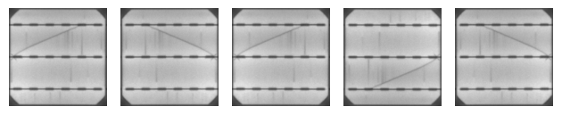
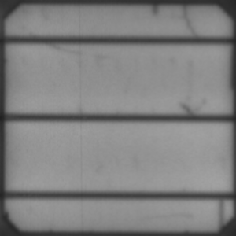
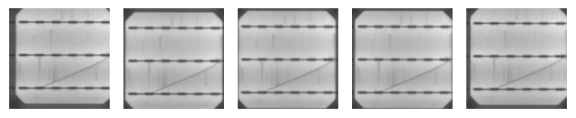
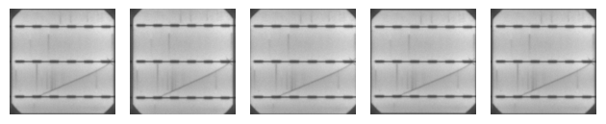
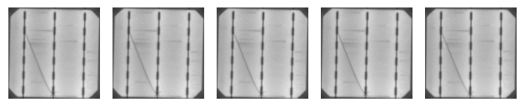
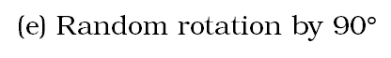
(b) Random horizontal and vertical flip
Metallic connection (a.k.a. busbar)
Translation axes
(c) Random horizontal and vertical shift
(d) Random zoom
(a) Anatomy of a solar cell
(e) Random rotation by 90$°$

Slide 7
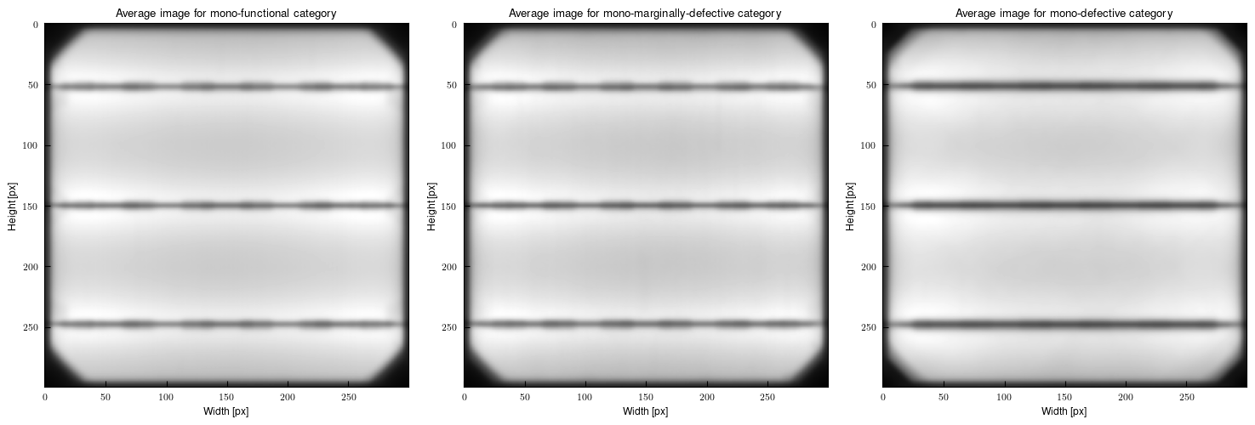
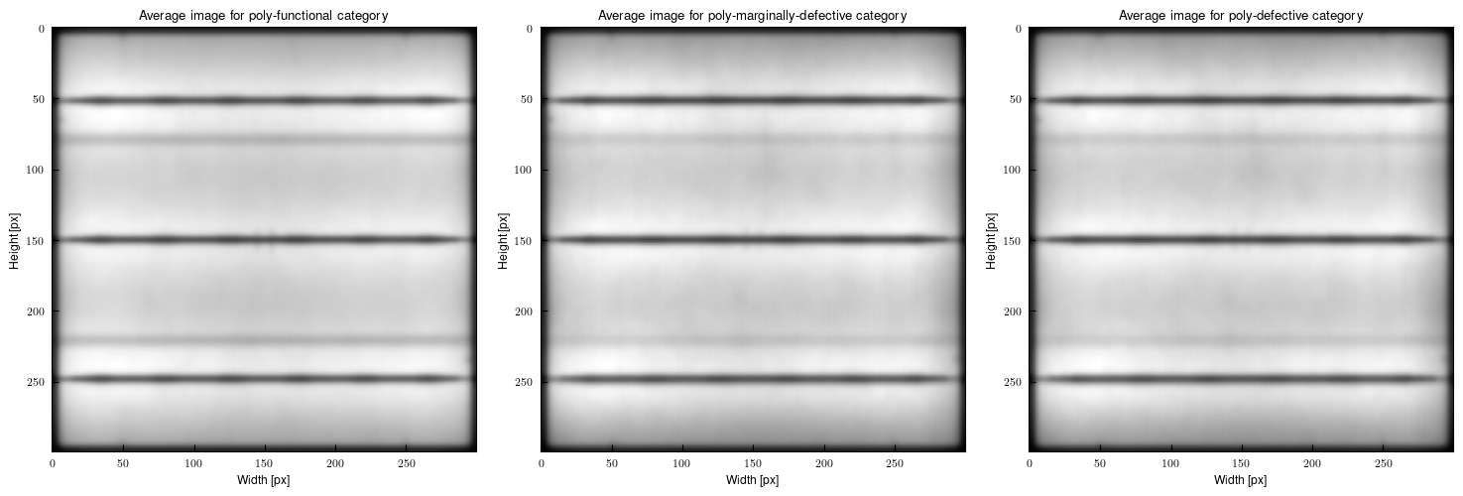
(a) Monocrystalline samples
(b) Polycrystalline samples

Slide 8
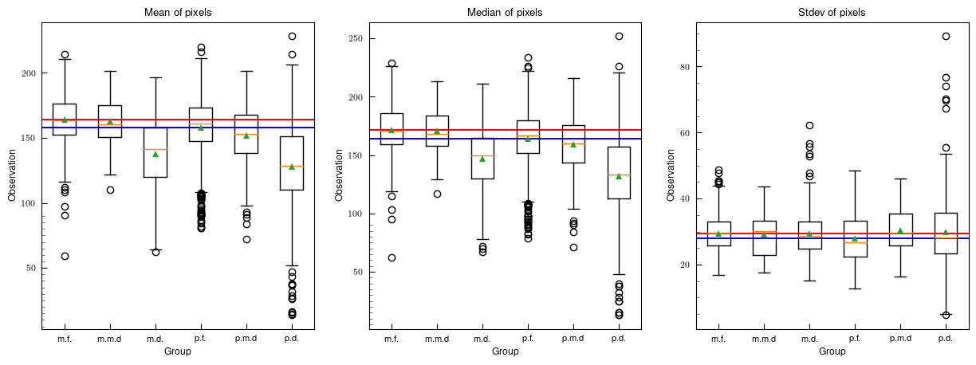
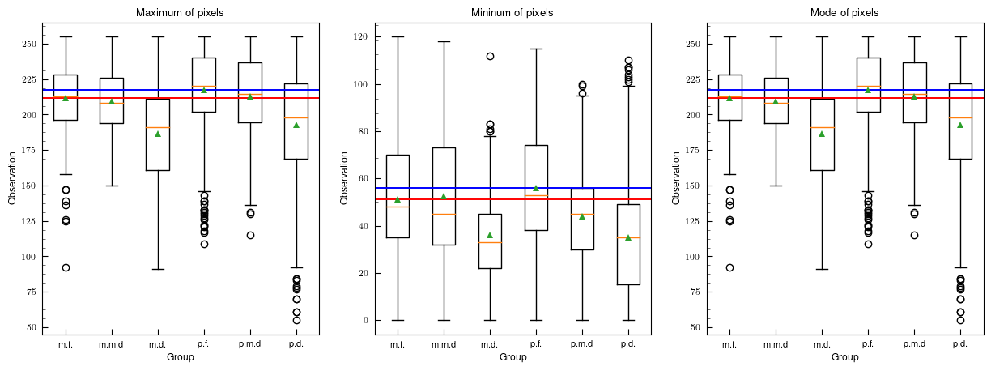

Slide 9
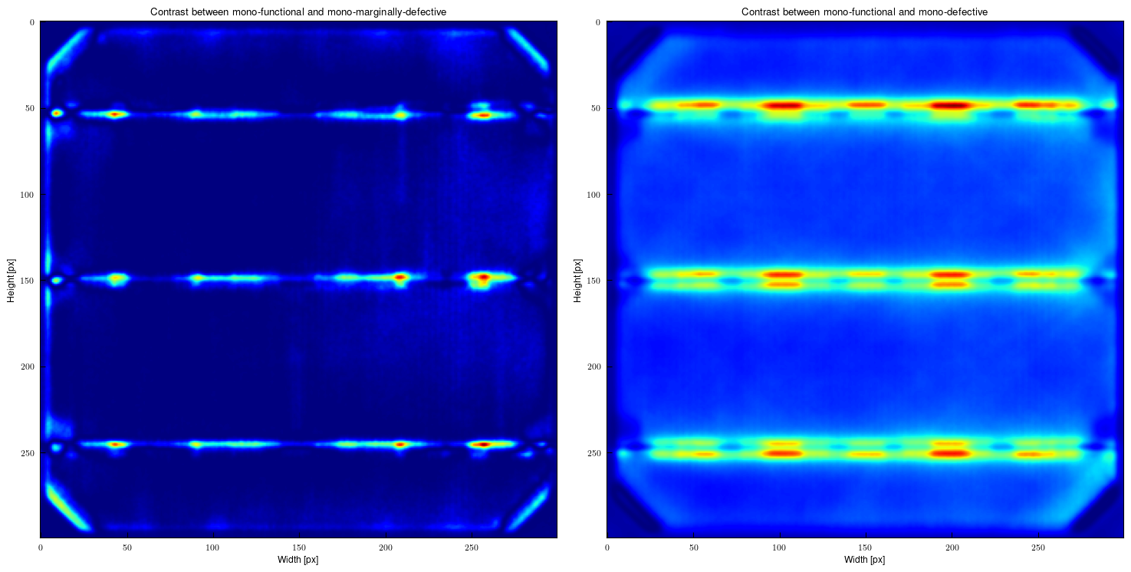
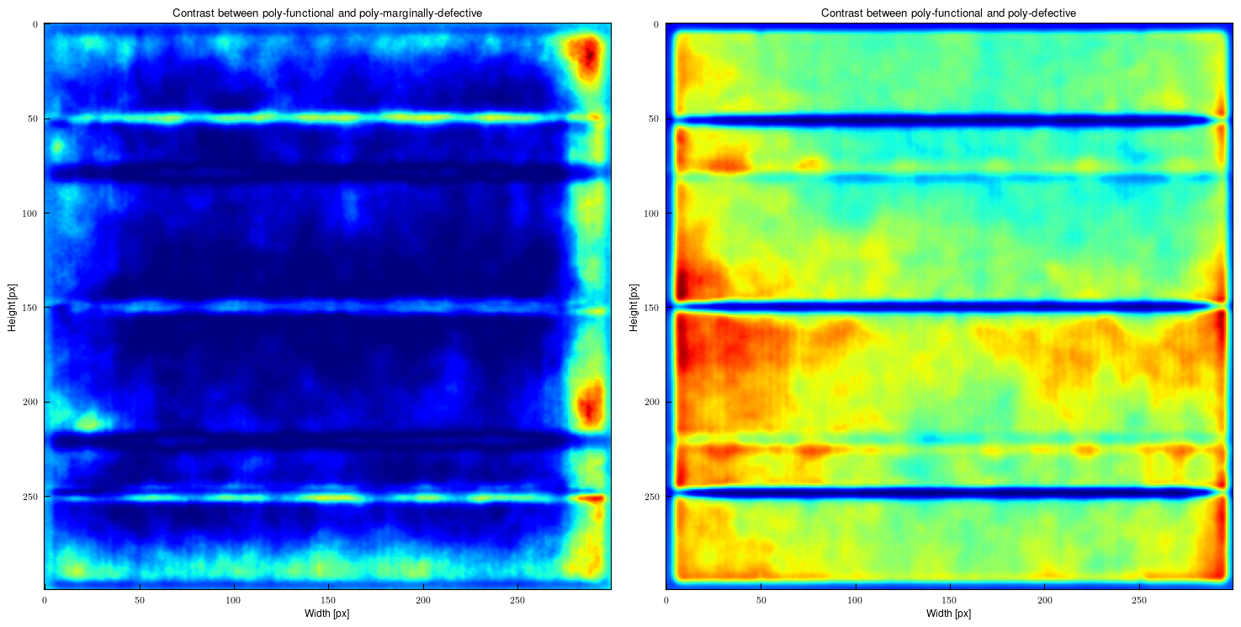
(a) Monocrystalline samples
(b) Polycrystalline samples

Slide 10
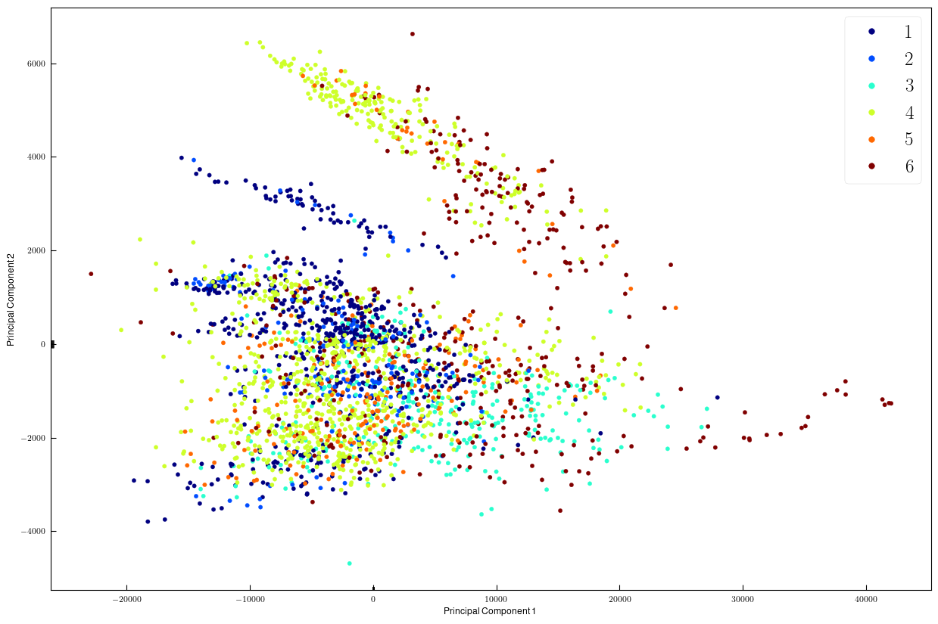
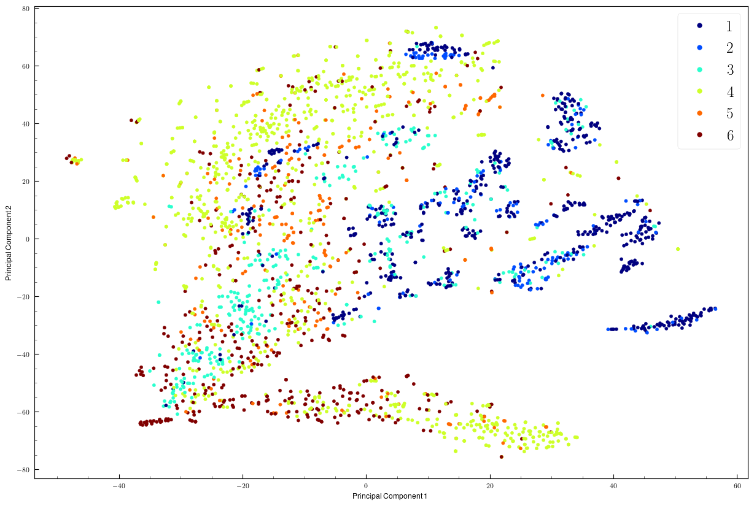
II
I
II
I
III
IV
III
IV
(a) PCA embedding
(b) t-SNE embedding

Slide 11
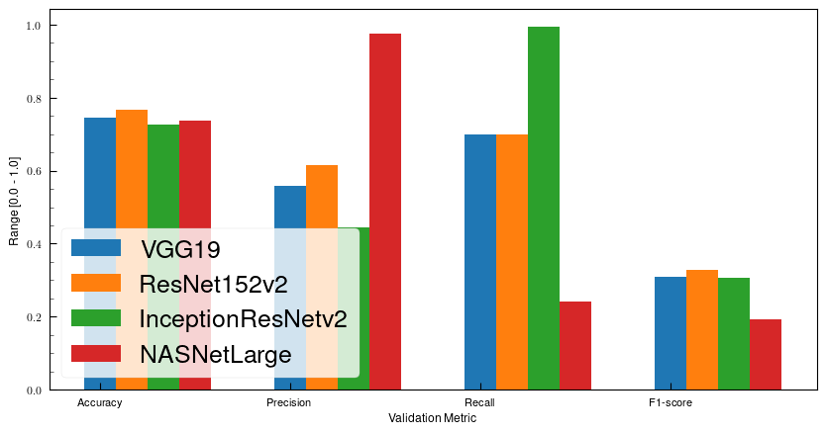
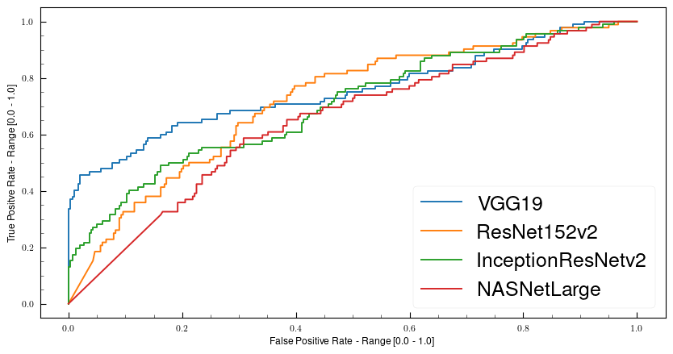
(a) Training Results
(b) ROC and AUC Results
 | A | B | C | D
Best Epoch* | 23 | 35 | 15 | 47
Accuracy | 0.7463 | 0.7672 | 0.7253 | 0.7373
Precision | 0.5574 | 0.6145 | 0.4437 | 0.9744
Recall | 0.6986 | 0.6986 | 0.9930 | 0.2405
F1-score | 0.6201 | 0.6539 | 0.6134 | 0.3857
 | A | B | C | D
AUC | 0.7557 | 0.7186 | 0.7040 | 0.6491
*: considering the second training phase

Slide 12
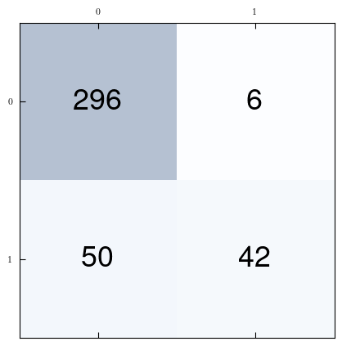
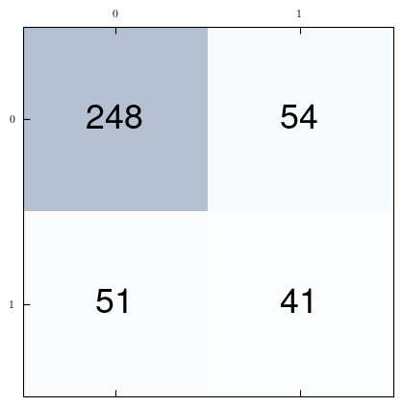
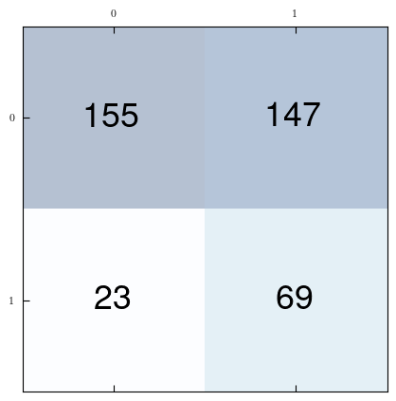
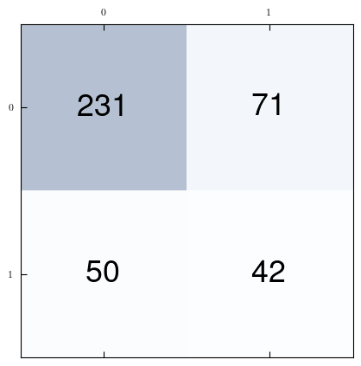
Actual Class
Actual Class
Predict Class
VGG19
Predict Class
ResNet152v2
Actual Class
Actual Class
Predict Class
InceptionResNetv2
Predict Class
NasNetLarge

Slide 13
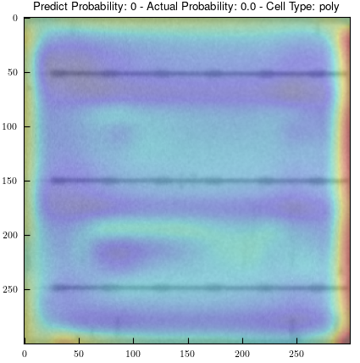
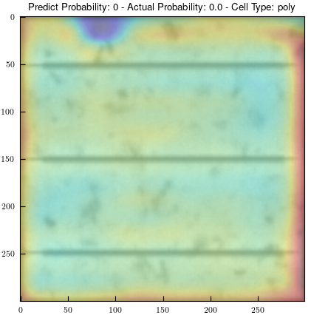
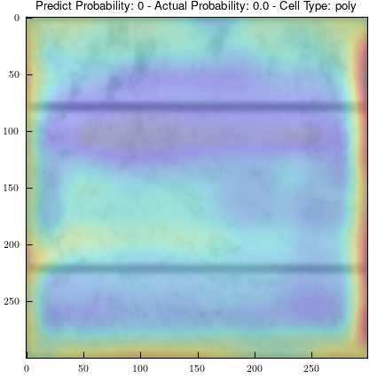
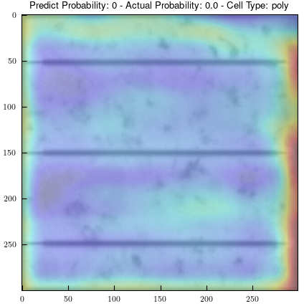
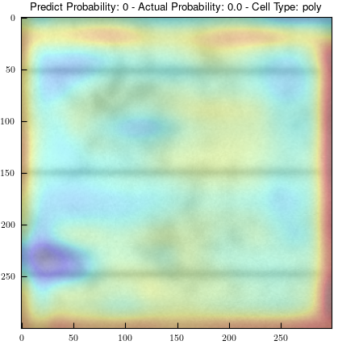

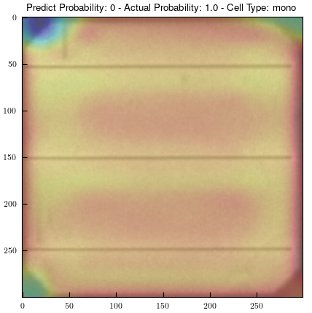
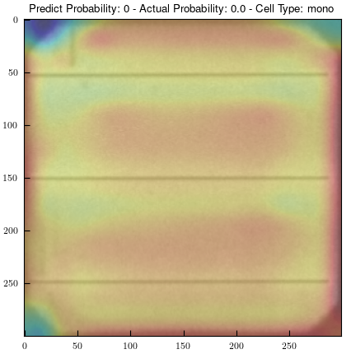
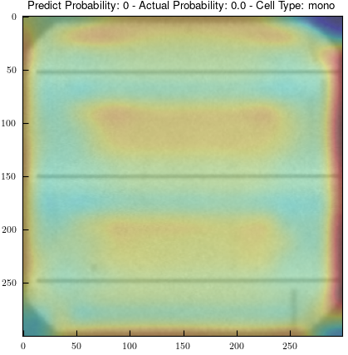
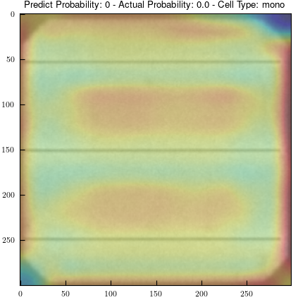
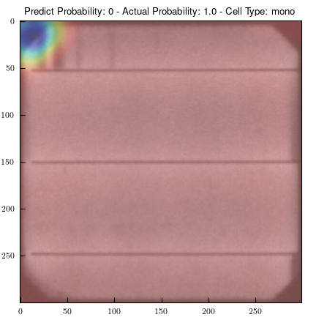

Model A
Polycrystalline
Correct
Correct
Correct
Correct
Correct
Monocrystalline
Wrong
Correct
Correct
Correct
Wrong

Slide 14
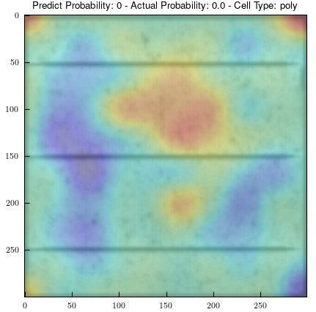
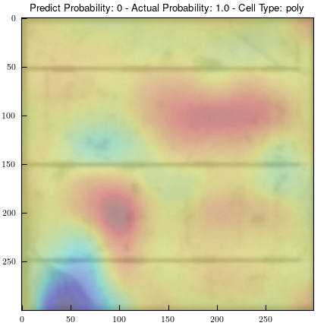
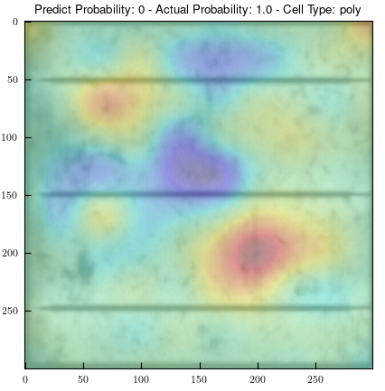
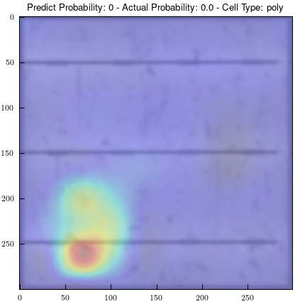
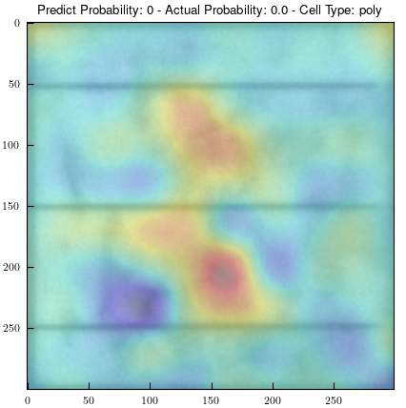
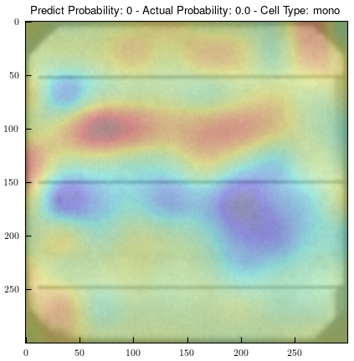
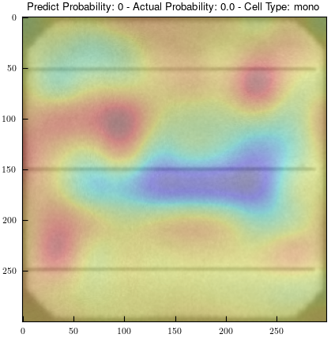
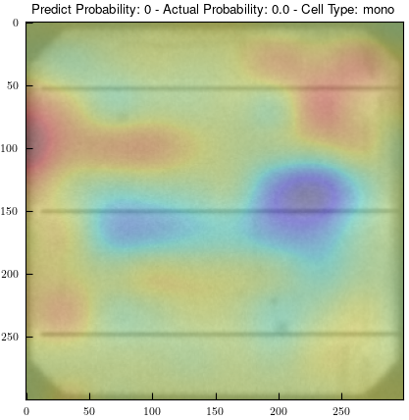
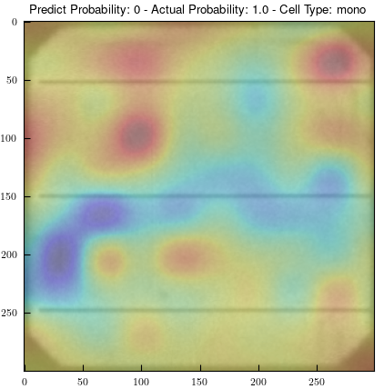
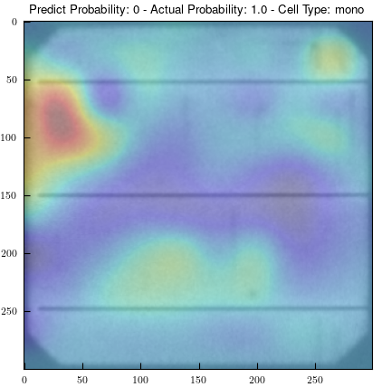
Model B
Polycrystalline
Correct
Wrong
Wrong
Correct
Correct
Monocrystalline
Correct
Correct
Correct
Wrong
Wrong

Slide 15
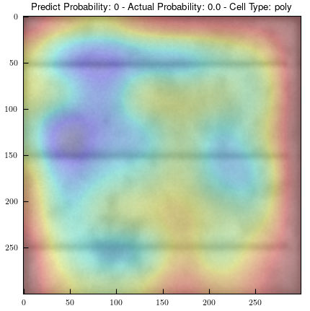
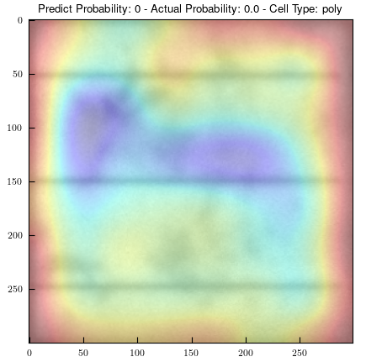
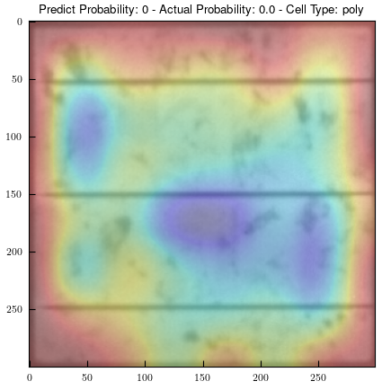
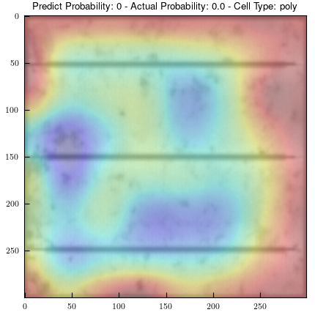
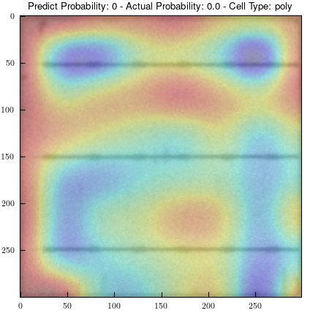
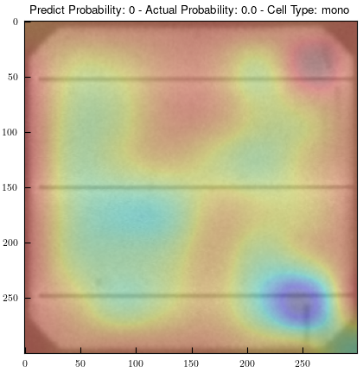
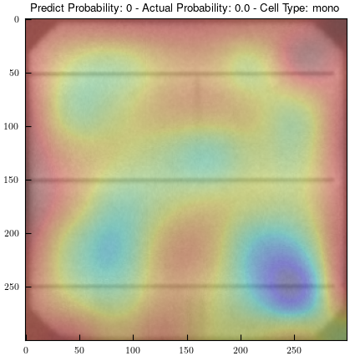
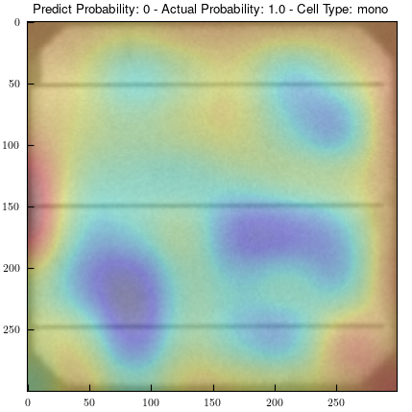
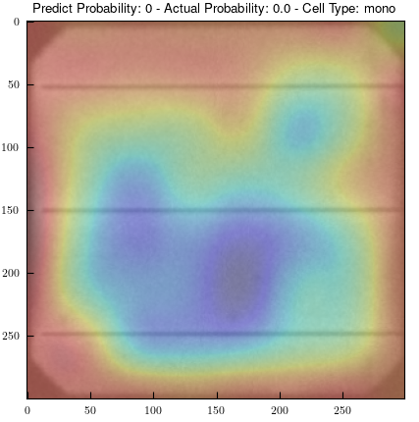
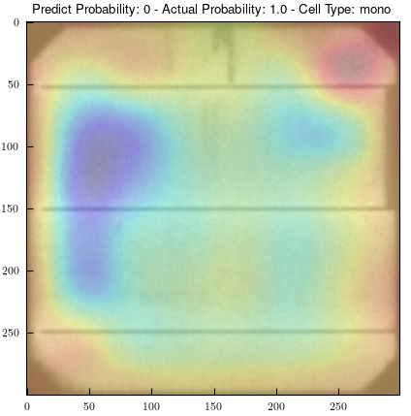
Model C
Polycrystalline
Correct
Correct
Correct
Correct
Correct
Monocrystalline
Correct
Correct
Wrong
Correct
Wrong

Slide 16









Model D
Polycrystalline
Correct
Correct
Wrong
Correct
Correct
Monocrystalline
Correct
Correct
Correct
Wrong
Wrong

Slide 17






Actual Probability: 0.0
DSSIM Score: 0.2224
Actual Probability: 1.0
DSSIM Score: 0.2182
Actual Probability: 0.0
DSSIM Score: 0.1392
Actual Probability: 1.0
DSSIM Score: 0.0128
Actual Probability: 0.0
DSSIM Score: 0.1754
Actual Probability: 0.0
DSSIM Score: 0.1258

